Slide 1

801 Skalleghi (-e)
13 CLUBS
Comitato SCSI:
AURELIE BOURCART – SECRÉTAIRE
ANAIS BAUD – PR & SOCIAL MEDIA
PETER BUTLER – PR & WEBSITE
GIANNI SARNO - TRÉSORIER
HENRI PERRENOUD – PAST PRESIDENT
DAVID FONTANELLA – PRESIDENT

Slide 2
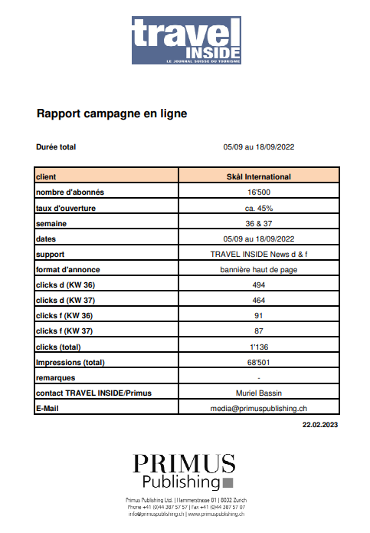


PUBLICITE TRAVEL INSIDE
Banner Top Page – Daily mailing
SEPTEMBRE 2022 - Travel Inside FR
Banner Top Page – Daily mailing
SEPTEMBRE 2022 - Travel Inside DE
Aumentare la visibilità SKAL
Totale impressioni (DE + FR) : 68’501

Slide 3




WEBSITE & SOCIAL NETWORKS
switzerland.skal.org
Seguiteci…

Slide 4
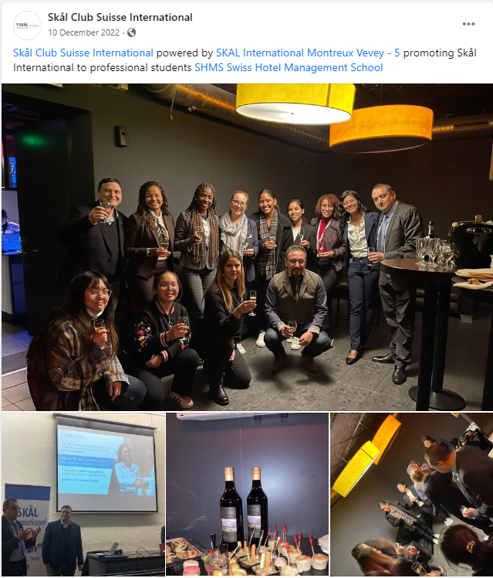
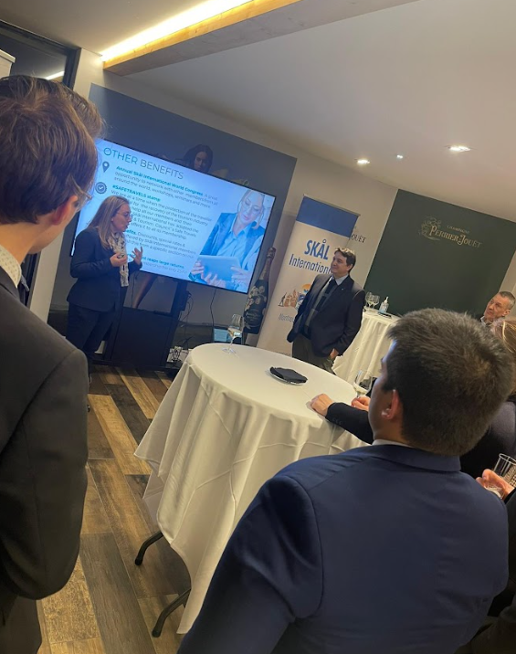
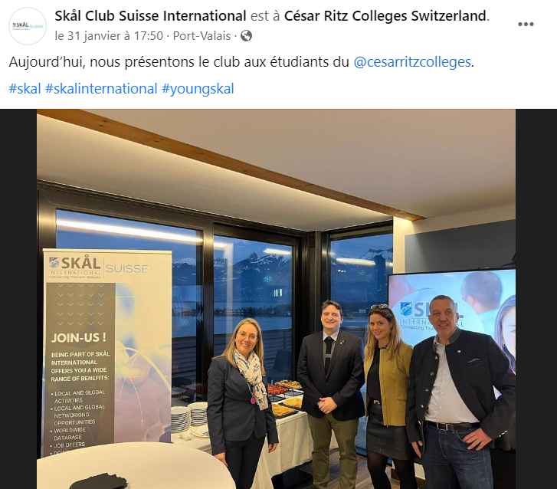
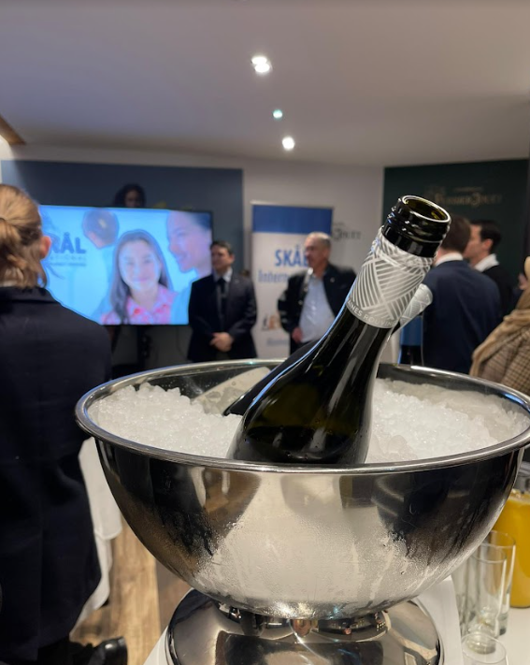
SCHOOL ROAD SHOW
1° EVENT:
08DEC22
SHMS CAUX
2nd Event
31JAN23
César Ritz Colleges
To be continued…

Slide 5
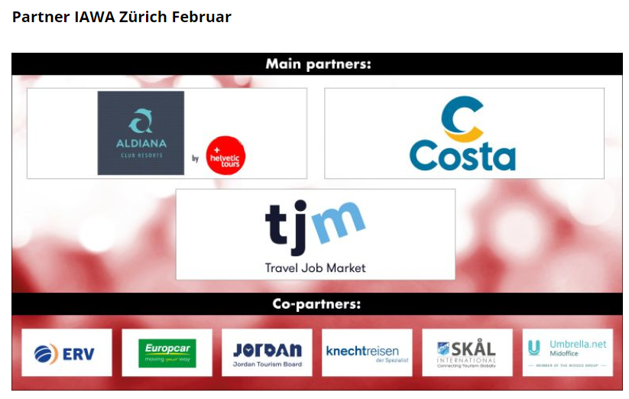
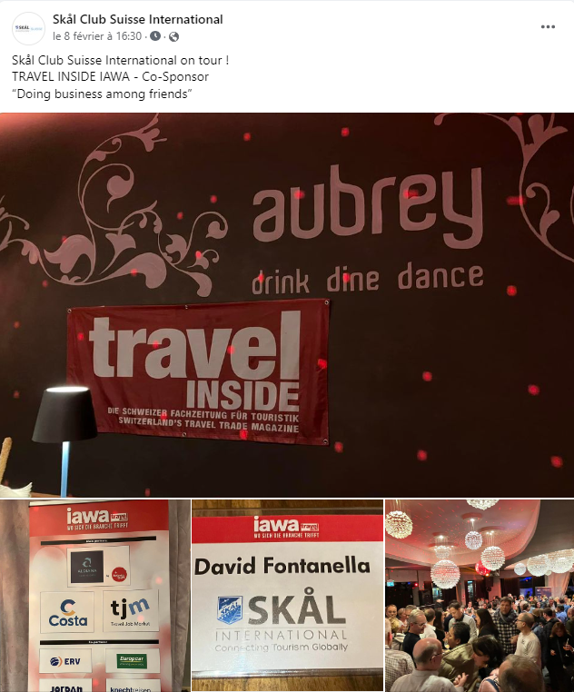

IAWA 2023: CO-SPONSOR
02/02 ZRH
11/05 GVA
01/06 LUZ
15/06 LAU
24/08 ZRH
19/10 BRN

Slide 6
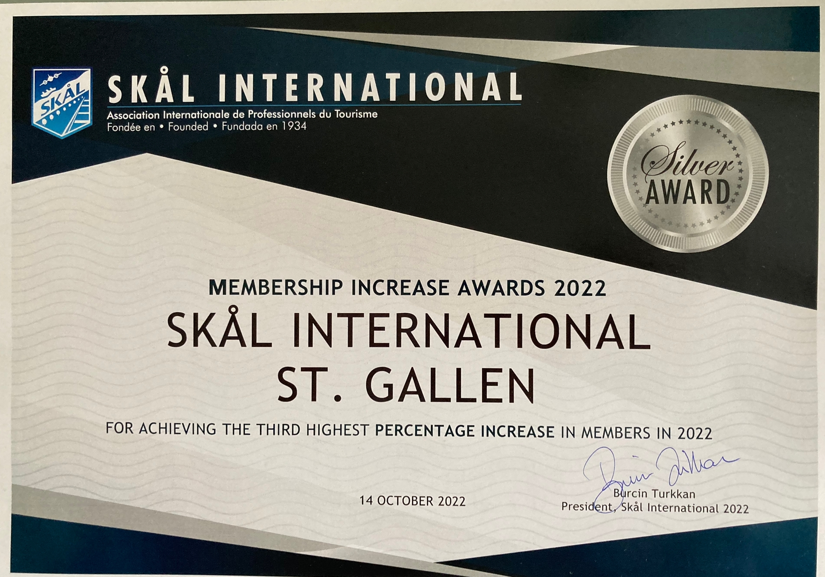
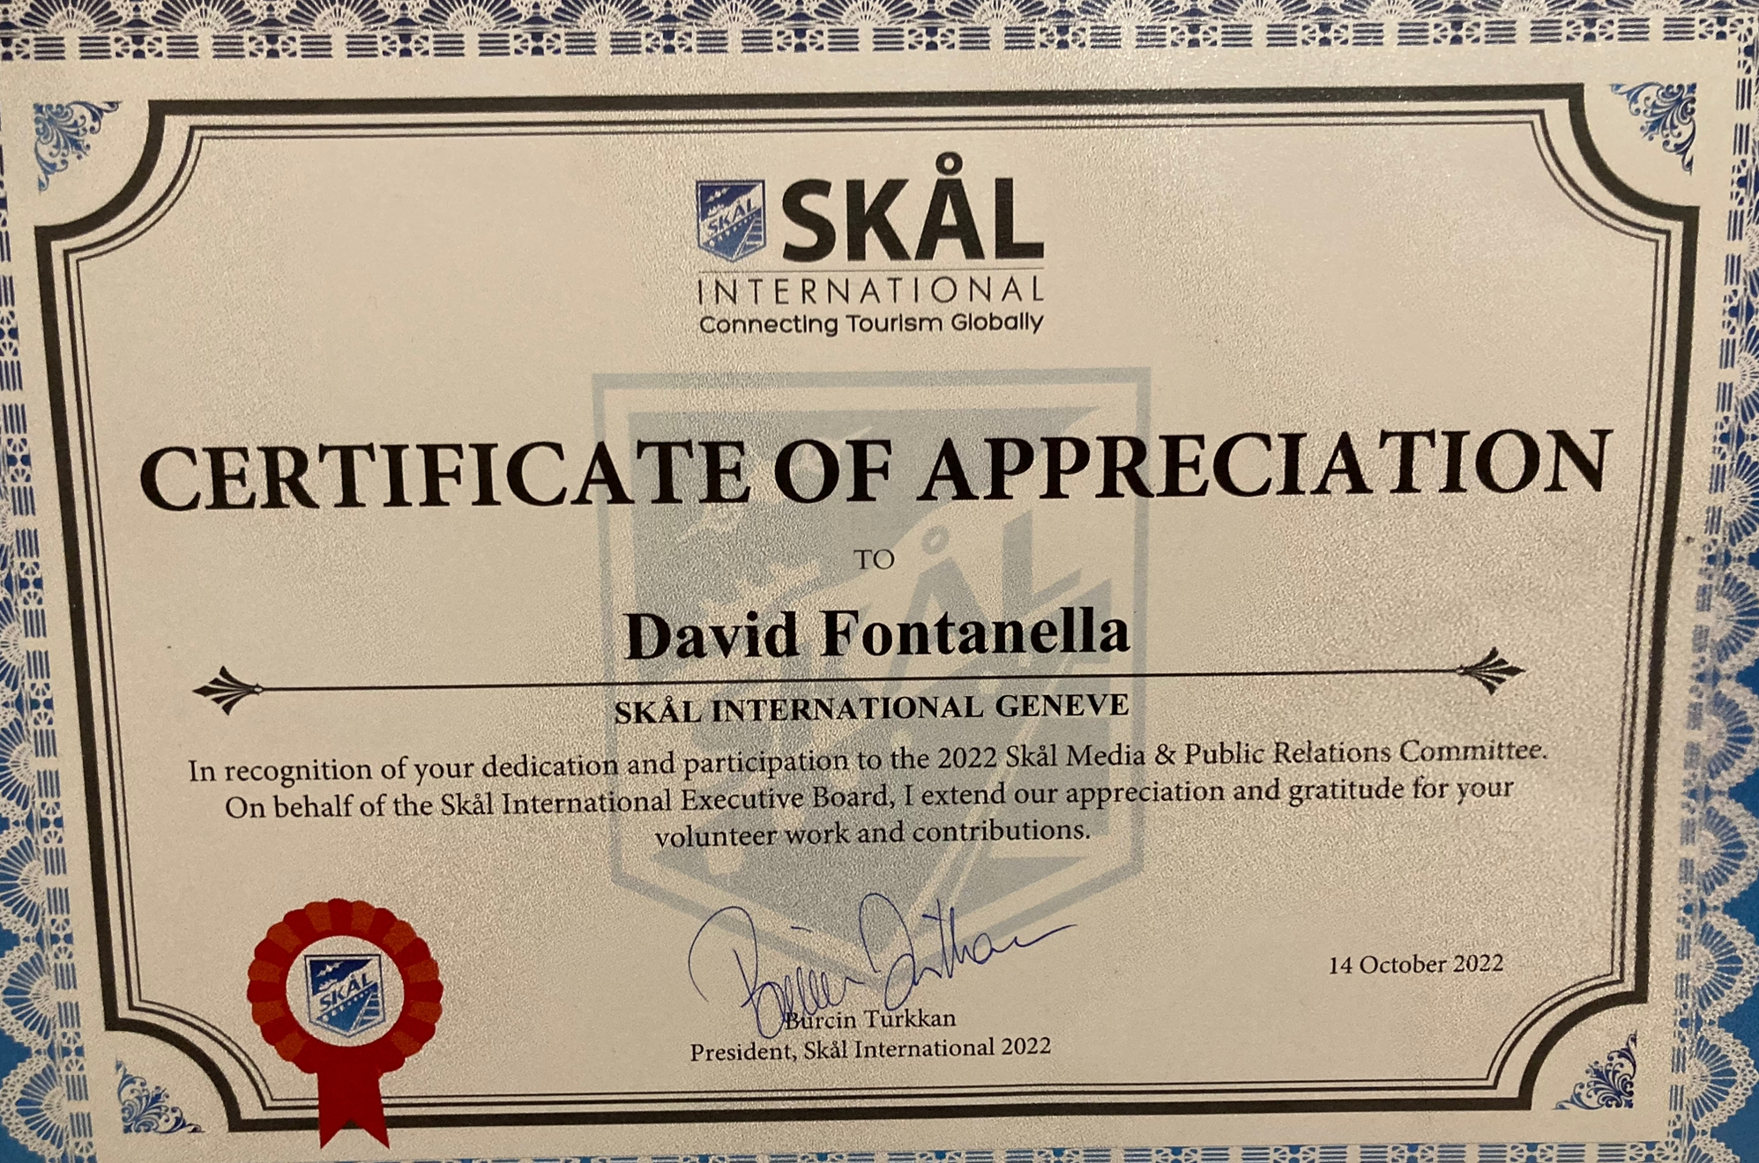
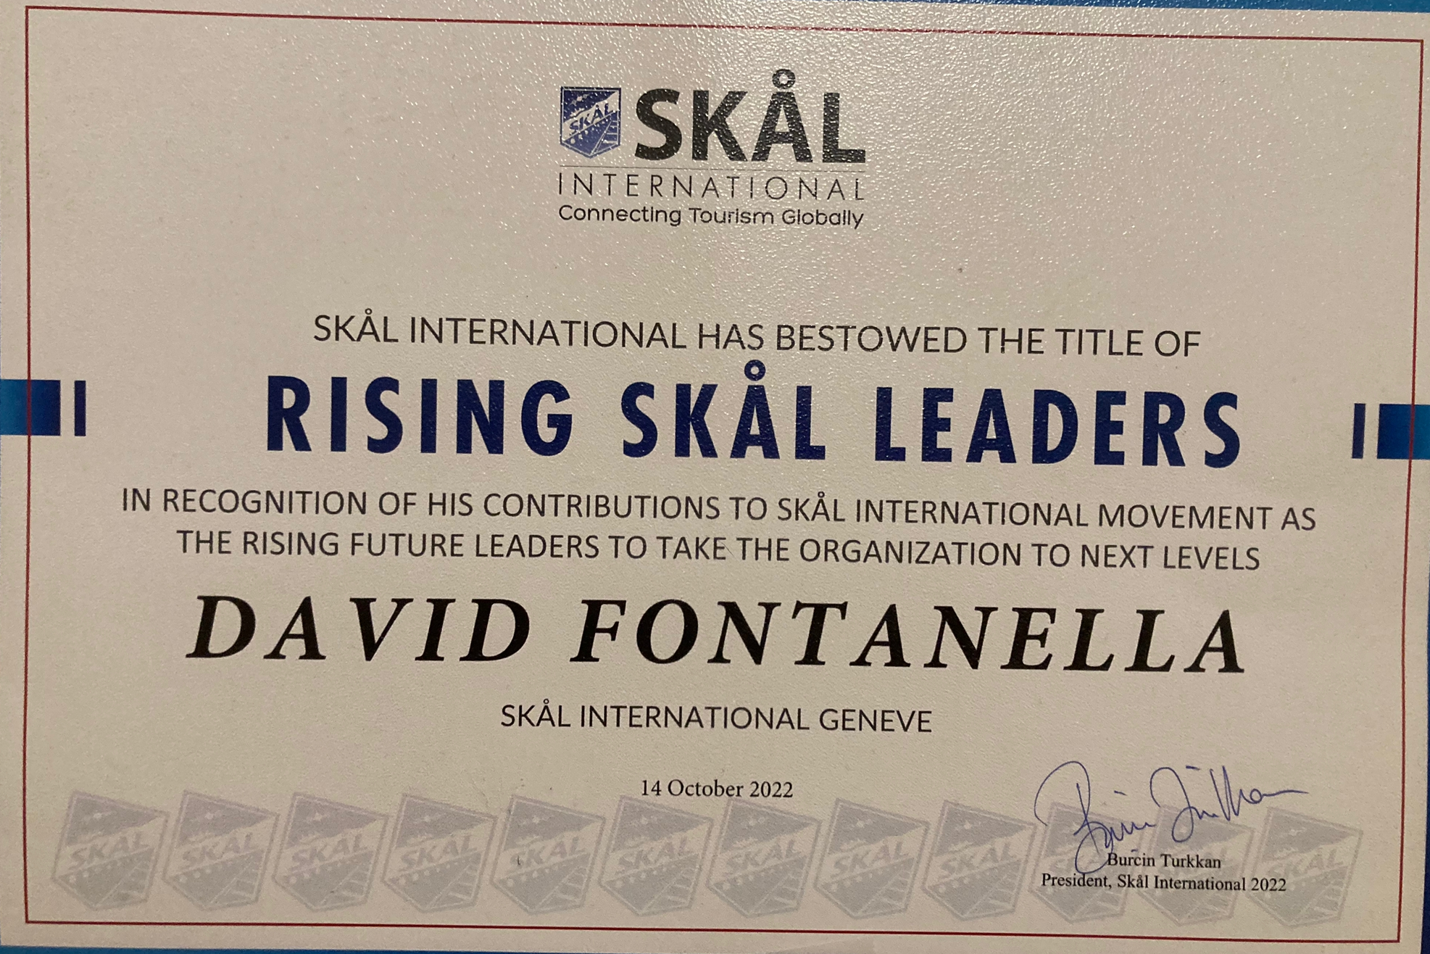
SKAL INTERNATIONAL:
- 2022 WORLD CONGRESS CROATIA: 400 PAX / 45 PAYS
- MAIN TOPIC: NEW WORLD SKAL STRUCTURE
- 2023 WORLD CONGRESS: QUEBEC (DECEMBER)
- AWARDS:
Siamo sulla strada giusta…!!!!

Slide 7



Member of:
DOING BUSINESS AMONG FRIENDS!!!!
Its more than 12958 members, entailing of industry’s Managers and Executives, meet at Local, National, Regional and International levels to do business among friends throughout more than 309 Skål Clubs along 86 countries.

